Slide 1
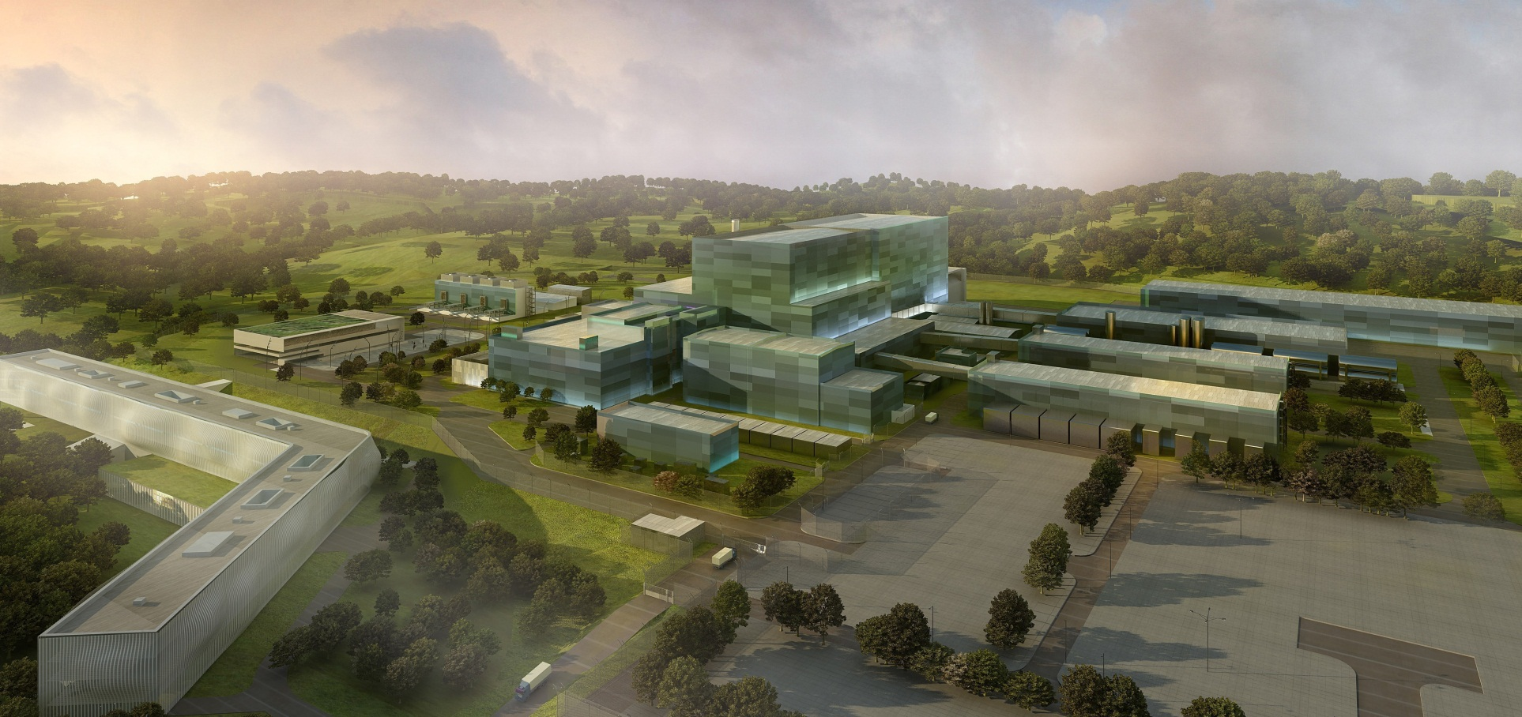
ITER Fast controller EPICS support
Vishnu Patel
ITER Organization
Control System Division

Slide 2
Content
Content
Introduction
Software Architecture
PXI-6259
Timing Board
PXIe-6368
PXI-6528
Conclusion

Slide 3
Goal for ITER CODAC (Control, Data Access and Communication)
Ensure all ITER Plant Systems Instrumentation & Control are designed, implemented and integrated such that ITER can be operated as a fully integrated and automated system.
Higher reliability and availability.

Slide 4
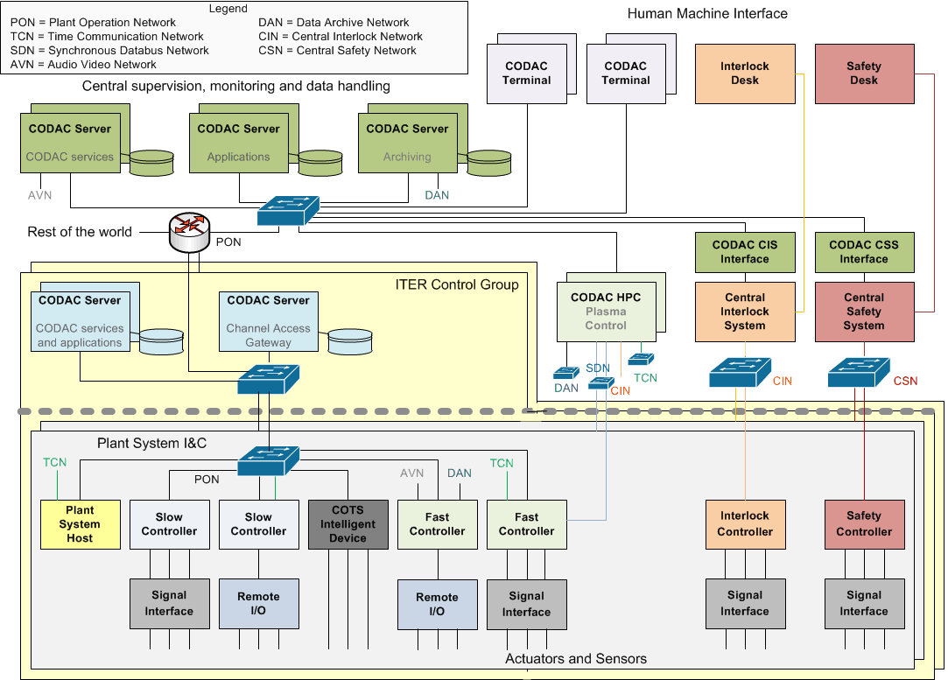
Physical Architecture

Slide 5
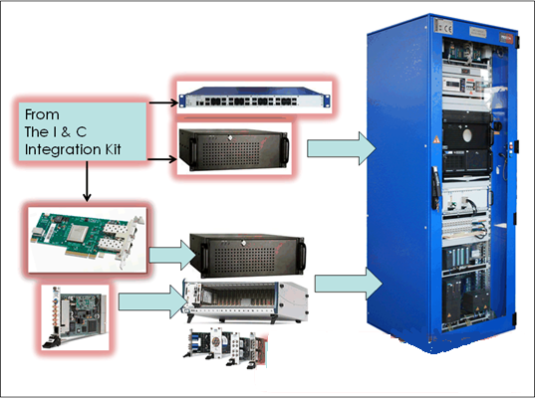
What constitutes a fast controller?
Industrial computer
I/O chassis as required
Interlinked with a PCI Express bus extension
In an I&C cubicle

Slide 6
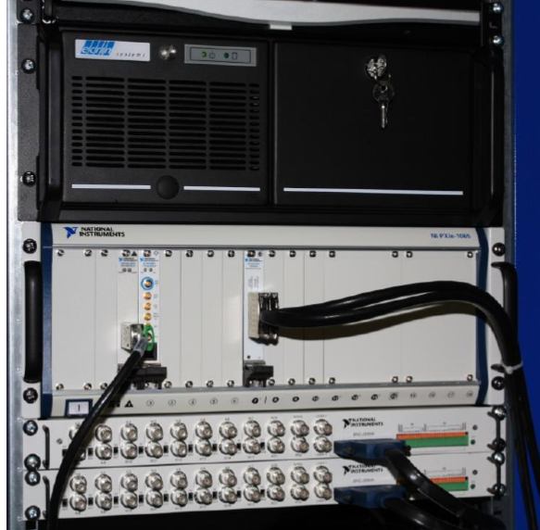
What constitutes a fast controller?
The industrial computer
I/O chassis (a PXIe rack)
TCN timing card NI PXI-6683H
A/D I/O card NI PXI-6259
Signal terminal block
(patch panel)

Slide 7
Standard I/O Boards
N.I. PXI-6682/PXI-6683H : Synchronization and timing (IEEE1588-2008 / TCN)
N.I. PXI-6259: multi-function data acquisition
16bits analog input channels (16 Diff. /32 Single Ended) (1.25MS/s)
16bits analog output channels (4) (2.86 MS/s)
Digital input/output channels (48)
N.I. PXIe-6368: High Performance multi-function data acquisition
16bits analog input channels (16 Diff.) (Simultaneous, 2MS/s)
16bits analog output channels (4) (3.3 MS/s)
Digital input/output channels (48)
N.I. PXI-6528 : Digital I/O
24 optically isolated input channels
24 solid-state relay output channels
N.I. PXIe-7961R : FlexRIO
Virtex-5 SX50T, 8160 FPGA Slices, 16 DMA Channels
N.I. PXIe-7966R : FlexRIO
Virtex-5 SX95T , 14720 FPGA Slices, 512MB DRAM, 16 DMA Channels 8160
The Supported boards are listed in the ITER Catalog of I&C products - Fast Controllers (345X28).

Slide 8
Software Architecture

Slide 9
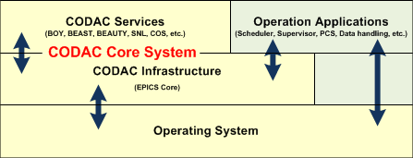
CODAC Core System
Operation Applications
The main challenge for CODAC is INTEGRATION

Slide 10
CODAC Core System (CCS)
CODAC
CODAC Terminal
Operator Interface (OPI)
Alarm views
Data plots
Control System Studio HMIs
Alarm server
Archive Server
CODAC Server
Alarm handling
Archiving
PON / CA
PSH:
I&C monitoring
PLCs Gateway
I&C coordination
PSH
PLC IOC
PSH IOC
Fast Controller
RT task
PCF
IOC
Fast Controller:
I/O interface
HPN interfaces: TCN, SDN, DAN
RT control
PLC
I/O
TCN
SDN
DAN

Slide 11
The Operating System(RHEL) & EPICS in CCS
ITER selected Red Hat Enterprise Linux for the x86-64 architecture (RHEL x86_64) & open source control system EPICS
CCS 4.3 -> RHEL 6.3 -> EPICS 3.14 , asynDriver 4.21
CCS 5.0 -> RHEL 6.5 -> EPICS 3.15 , asynDriver 4.23 (Feb 2015)
For fast feedback control a real-time enabled version of RHEL, RHEL MRG-R, is deployed.
Optimized kernel for real-time applications
More deterministic latencies / reduced jitter

Slide 12
Standard Software Support
CODAC Core System includes the software for ITER standard I/O boards
Linux driver
EPICS integration (EPICS device support)
SDD integration (configuration via SDD tools)

Slide 13
Self-Description Data Definition (SDD) Editor

Slide 14
EPICS device support
Basic EPICS Device Driver
. PXI-6259: multi-function data acquisition.
asynDriver based Device Driver
PXI-6682 & PXI-6683h : Synchronization and timing.
PXIe-6368: High Performance multi-function data acquisition.
PXI-6528 : Digital I/O.
Future device Support
FlexRIO boards (PXIe-7961R/PXIe-7966R ).
cRIO.

Slide 15
PXI 6259 DAQ Board

Slide 16
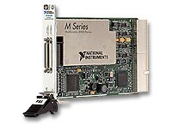
PXI 6259 DAQ Board
AI Channels
Channel : 32 Single-Ended Channels
/16 Differential Channels
Sample rate : 1.25Ms/s single channels
1Ms/s multi channels (all)
AO Channels
Channel : 4
Update rate :
1.25Ms/s per each channel (4 Ch)
2.86MS/s (1 Ch)
Digital I/O
Bidirectional Channel : 48

Slide 17
PXI 6259 Board functions
General
Device Information
Software version
DAQ mode Support
Software timed acquisition
Hardware timed acquisition
Finite sample mode
Continuous mode
Clock Settings
Sampling rate
Clock Source
Clock divider
Triggering
Set trigger
Software
Hardware (Start, Stop & Pause Trigger)
Pre & Post samples

Slide 18
PXI 6259 Board functions
DIO configuration
Analog Output configuration.
General purpose counter
Signal routing

Slide 19
PXI 6259 Templates
Board level EPICS Template
EPICS PV Prefix :- $(CBS1)-$(CBS2)-HWCF:6259-$(BOARDTYPEIDX)-
Channel level EPICS Template.
EPICS PV Prefix :- $(CBS1)-$(CBS2)-HWCF:6259-$(BOARDTYPEIDX)-AI$(CHIDX)-
Function | PV Suffix | Record type | Description
num_samples | NS | longout | Set Number of sample to read
sample_rate | SR | longout | Set sampling rate of AI
BoardStatus | BS | mbbi | Read Board status
switch_acquisition | ACQ | bo | Start/Stop data acquisition
daq_mode | MODE | bo | Set Continuous or Finite AI acquisition mode
pretrig_samples | PRET | longout | Set Pre-trigger sample for AI acquisition
posttrig_samples | POST | longout | Set Post-trigger sample for AI acquisition
ai_conf | CONF | bo | Load/Reset AI configuration
Function | PV Suffix | Record type | Description
samples_read | SR | longin | Read Analog input of selected channel
channel_type | CT | mbbo | Set Channel Type (NRSE/RSE/DIFFERENTIAL

Slide 20
Timing Boards (PXI-6682 & PXI-6683H)

Slide 21
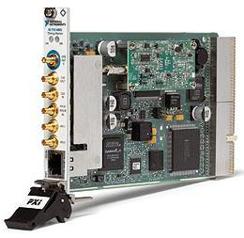
Timing Boards Functions
Receive ITER time
Synchronization of system time with Board time
Generate Future time events, Pulse and Clocks
Front panel connector
PXI backplane lines
Synchronized event generation
Signal routing
Clock routing
Accurate Time-stamping of event
External events (Front panel
connector & Backplane lines)
Pulse sequence Programming on
the selected terminal.

Slide 22
Timing Boards Templates
Device Information
EPICS PV Prefix :- $(CBS1)-$(CBS2)-HWCF:$(SHORTBOARDTYPE)-$(BOARDTYPEIDX)-
Clock Routing
EPICS PV Prefix :- $(CBS1)-$(CBS2)-HWCF:$(SHORTBOARDTYPE)-$(BOARDTYPEIDX)-
Board templates are
nisync_clock_route.template -> 6 PVs
nisync_device_info.template -> 15PVs
Terminal Templates are
nisync_terminal.template -> 44 PVs
nisync_timing_program.template -> 4PVs
Function | PV Suffix | Record type | Description
getTime | BDTM | waveform | Read Board time in second, nanosecond
getTime | HBDTM | stringin | Read Board time in Human readable format
deviceName | DEVNAME | stringin | Get device name
driverVersion | DRIVER | stringin | Get Linux driver version
abortAllFtes | FTEAALL | bo | Aboard all pending FTES
maxScheduledFtes | FTRMAX | Longin | Read Maximum number of scheduled Ftes
numPendingFtes | FTENUM | Loingin | Read number of pending FTEs
checkFteLevels | LVL_ERRS | longin | Check FTE level sequence error
deviceSerialNumber | SERIAL | loingin | Get device serial number
deviceStatus | STAT | mbbi | Get device status
syncStatus | SYNC | mbbi | Get device synchronization status
resetCard | RESET | bo | Reset the Device
Function | PV Suffix | Record type | Description
clockSource | BKPCMON | mbbi | Read Backplane clock source
clockSource | BKPSRC | mbbo | Connect the selected source clock to the Backplane clock
clockSource | CLKOMON | mbbi | Read Clock-out clock source
clockSource | CLKOSRC | mbbo | Connect the selected source clock to the to the Clock-out
clockSource | TMKCMON | mbbi | Read Time keeper clock source
clockSource | TMCSRC | mbbo | Connect the selected source clock to the to the Time keeper clock

Slide 23
Timing Boards Templates
Device Terminals
EPICS PV Prefix :- $(CBS1)-$(CBS2)-HWCF:$(SHORTBOARDTYPE)-$(BOARDTYPEIDX)T$(CHIDX)-
Pulse Generation Records
Future Time Event Records
Timestamp Records
Clock Generation Records
Function | PV Suffix | Record type | Description
fteEnable | FTEE | bo | Enable or disable future time event
fteStatus | FTEM | bi | Returns whether future time event is enabled
fteTimeSec | FTES | ao | Set second part of the FTE time
fteTimeNsec | FTEN | longout | Set nano second part of the FTE time
fteLevel | FTEL | bo | Set level of future time event
fteGenerate | FTE | bo | Generate FTE with configured time
fteAbort | FTEA | bo | Abort FTE for configured time
Function | PV Suffix | Record type | Description
clockEnable | CLOCKE | bo | Enable or disable clock generation
clockStatus | CLOCKM | bi | Returns whether clock is enabled
clockStartSec | CLOCKSS | ao | Set second part of the clock start time
clockStartNsec | CLOCKSN | longout | Set nano second part of the clock start time
clockEndSec | CLOCKES | ao | Set second part of the clock end time
clockEndNsec | CLOCKEN | longout | Set nano second part of the clock end time
clockPeriod | CLOCKP | ao | Set Clock period
clockDuty | CLOCKD | ao | Set Clock duty cycle
clockGenerate | CLOCK | bo | Generate clock with configured time
Function | PV Suffix | Record type | Description
timestampControlEdge | TSCG | mbbo | Set detection edge
timestampControlDecCount | TSDC | longout | Sets the decimation count for timestamping
timestampControlEnable | TSEN | bo | Enable or Disable timestamping
timestampRead | TS | waveform | Timestamp is read with 3 element waveform (second, nano-second, edge)
timestampStatusEnable | TSM | bi | Returns whether timestamping is enabled
timestampStatusEdge | TSMG | mbbi | Returns detection edge for timestamping
timestampStatusDecCount | TSMDC | longin | Returns decimation count for timestamps
Function | PV Suffix | Record type | Description
pulseEnable | PLUSEE | bo | Enable or disable pulse generation
pulseStatus | PLUSEM | bi | Returns whether pulse is enabled
pulseTimeSec | PULSES | ao | Set second part of the pulse time
pulseTimeNsec | PULSEN | longout | Set nano second part of the pulse time
pulseWidth | PULSEW | ao | Set pulse width
pulseInvert | PULSEI | bo | Set pulse inversion
pulseGenerate | PULSE | bo | Generate PULSE with configured time

Slide 24
Timing Boards Templates
Device Terminals
EPICS PV Prefix :- $(CBS1)-$(CBS2)-HWCF:$(SHORTBOARDTYPE)-$(BOARDTYPEIDX)T$(CHIDX)-
Pulse Generation Records
Future Time Event Records
Timestamp Records
Clock Generation Records
Function | PV Suffix | Record type | Description
fteEnable | FTEE | bo | Enable or disable future time event
fteStatus | FTEM | bi | Returns whether future time event is enabled
fteTimeSec | FTES | ao | Set second part of the FTE time
fteTimeNsec | FTEN | longout | Set nano second part of the FTE time
fteLevel | FTEL | bo | Set level of future time event
fteGenerate | FTE | bo | Generate FTE with configured time
fteAbort | FTEA | bo | Abort FTE for configured time
Function | PV Suffix | Record type | Description
clockEnable | CLOCKE | bo | Enable or disable clock generation
clockStatus | CLOCKM | bi | Returns whether clock is enabled
clockStartSec | CLOCKSS | ao | Set second part of the clock start time
clockStartNsec | CLOCKSN | longout | Set nano second part of the clock start time
clockEndSec | CLOCKES | ao | Set second part of the clock end time
clockEndNsec | CLOCKEN | longout | Set nano second part of the clock end time
clockPeriod | CLOCKP | ao | Set Clock period
clockDuty | CLOCKD | ao | Set Clock duty cycle
clockGenerate | CLOCK | bo | Generate clock with configured time
Function | PV Suffix | Record type | Description
timestampControlEdge | TSCG | mbbo | Set detection edge
timestampControlDecCount | TSDC | longout | Sets the decimation count for timestamping
timestampControlEnable | TSEN | bo | Enable or Disable timestamping
timestampRead | TS | waveform | Timestamp is read with 3 element waveform (second, nano-second, edge)
timestampStatusEnable | TSM | bi | Returns whether timestamping is enabled
timestampStatusEdge | TSMG | mbbi | Returns detection edge for timestamping
timestampStatusDecCount | TSMDC | longin | Returns decimation count for timestamps
Function | PV Suffix | Record type | Description
pulseEnable | PLUSEE | bo | Enable or disable pulse generation
pulseStatus | PLUSEM | bi | Returns whether pulse is enabled
pulseTimeSec | PULSES | ao | Set second part of the pulse time
pulseTimeNsec | PULSEN | longout | Set nano second part of the pulse time
pulseWidth | PULSEW | ao | Set pulse width
pulseInvert | PULSEI | bo | Set pulse inversion
pulseGenerate | PULSE | bo | Generate PULSE with configured time

Slide 25
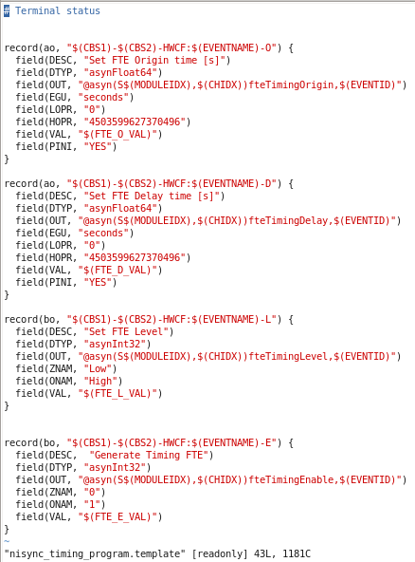
EPICS interface for pulse time
One timing is defined by the following PVs:
Control of the time origin (suffix: “-O”), expressed as a double and representing an absolute time in seconds.
Control of the time offset from the origin , called delay (suffix: “-D”), expressed as a double and representing a time in seconds with the resolution of a nano-second and with an absolute limit of one day.
Control of the terminal line level (suffix: “-L”) to High or Low.
An enable/disable flag (suffix: “-E”) for adding/removing the timing to the list of FTEs.

Slide 26
PXIe-6368 DAQ Board

Slide 27
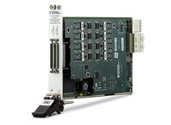
PXIe-6368 DAQ Board
16 simultaneous analog inputs at 2MS/s/ch , 32MS/s total AI throughput (16 bit resolution)
Four analog outputs, 3.33 MS/s (16 bit resolution)
48 digital I/O lines
32 hardware-timed up to 10MHz
16 PFI
Four 32 bit counters
Analog and digital triggering
Acquisition mode.
Continuous
Finite sample
Reference triggered

Slide 28
PXIe-6368 DAQ Board Function
All the Functions for PXI-6259
Retriggerable acquisition mode
Board level and Channel level EPICS Template.
waveform and ai record support for Analog input.
DIO configuration with EPICS PVs.
Analog Output configuration with EPICS PVs.

Slide 29
PXIe 6368 Templates
Board level EPICS Template
EPICS PV Prefix :- $(CBS1)-$(CBS2)-HWCF:6368-$(BOARDTYPEIDX)-
Channel level EPICS Template.
EPICS PV Prefix :- $(CBS1)-$(CBS2)-HWCF:6368-$(BOARDTYPEIDX)-AI$(CHIDX)-
Function | PV Suffix | Record type | Description
change_ai_mode | CHAIMO | mbbo | Change the AI acquisition mode
reset_load_ai | LDAICF | bo | Load/Reset AI configuration
no_of_samples | AISMPL | longout | Number of AI sample to be acquire
pulse_ai | AIPU | mbbo | Generate Software pulse for AI
sampling_rate_ai | AISR | longout | Set AI sampling rate
start_stop_ai | AISTSP | bo | Start/Stop Analog acquisition
timebase_ai | AITB | longout | Set AI timebase source
Function | PV Suffix | Record type | Description
Read_ai | AIW$(CHIDX) | waveform | Read AI samples of channel $(CHIDX)

Slide 30
PXI-6528 DIO Board

Slide 31
PXI-6528 DIO Board Functions
Read Device information
Bit and Byte write/read on hardware port (3 input and 3 output ports)
Signal routine.
Watchdog configuration
Level change on watchdog
Level change detection
Input port filter
Output port Power up state
client / asynUser
Byte
Bit
interface
driver
bus controller (port)

Slide 32
PXI-6528 Templates
EPICS PV Prefix :- $(CBS1)-$(CBS2)-HWCF:6528-$(BOARDTYPEIDX)-
Function | PV Suffix | Record type | Description
noboard | BS | bi | Give board presence
setfilterinterval | FILTINT | longout | Configure the internal filter interval
setrtsiinputroute | RTSIINPROUT | longout | Select the RTSI input port lines
setrtsioutputroute | RTSIOUTROUT | longout | Select the RTSI Output port lines
setrtsiwatchdogtrigger | RTSIWDGTRIG | longout | Configure an RTSI line to act as a hardware trigger for the watchdog timer.
setwatchdogtimeout | WDGTOUT | ao | Set watchdog timeout
setportpowerup | POWERP3 | longout | Set port3 power up state
setportpowerup | POWERP4 | longout | Set port4 power up state
setportpowerup | POWERP5 | longout | Set port5 power up state

Slide 33
Management Tools
Tool | Scope | Reference
Subversion | Software source code evolution | https://svnpub.iter.org/codac
Bugzilla | Issue tracker | https://bugzilla.iter.org/codac
Central SDD | I&C production projects | https://sdd.iter.org
CLM | Inventory control | https://psp.iter.org/PsProfile/page/inventory/

Slide 34
Conclusion
Developments and distribution of EPICS Device Drivers are stable.
PXI-6259
Timing Boards (PXI-6682 & PXI-6683H
PXI-6528
ALL of the requirement for PXI-6259, Timing boards (PXI-6682 & PXI-6683H) and PXI-6528 are completed
PXIe-6368 EPICS device Driver is under progress.
More efforts will be applied in improvement.
Thank you

